Slide 1


Ministry of higher Education and Scientific Research
University of Basrah Al-zahra college of medicine
Academic year 2025-2026
4th year S-3
Cardiovascular Module
Session
Heart failure
Dr. Mazin Abed Hazza

Slide 2
Ministry of higher Education and Scientific Research
University of Basrah Al-zahra college of medicine
Objective
Definition of HF
Understanding the pathophysiology
Classification of heart failure
Etiology and risk factors for HF
Clinical features and diagnosis.
Mangement

Slide 3
Ministry of higher Education and Scientific Research
University of Basrah Al-zahra college of medicine
Definition
Inability of the heart to maintain adequate cardiac output, or it can maintain that on expense of high venous pressure.

Slide 4
Ministry of higher Education and Scientific Research
University of Basrah Al-zahra college of medicine
Etiology
IHD
HTN
DM
VHD
CHD
Crdiomyopathies
Arrythmia induced
Myocarditis.
LBBB
Obesity induced

Slide 5
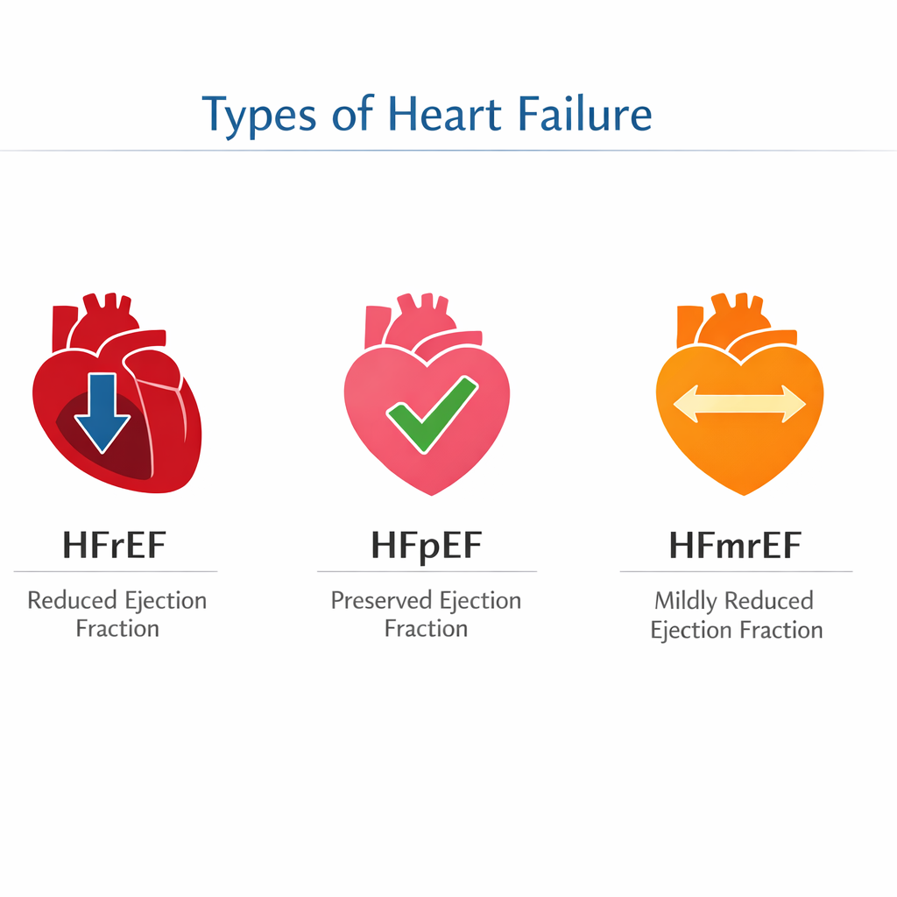
Ministry of higher Education and Scientific Research
University of Basrah Al-zahra college of medicine
classification

Slide 6
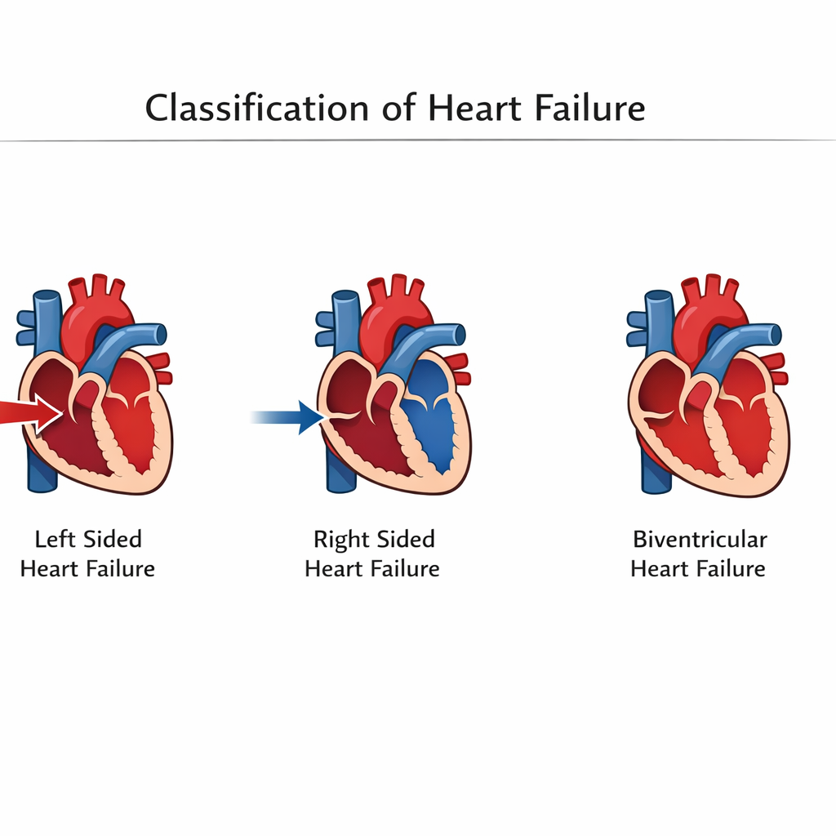
Ministry of higher Education and Scientific Research
University of Basrah Al-zahra college of medicine
Classification of HF

Slide 7
Ministry of higher Education and Scientific Research
University of Basrah Al-zahra college of medicine
Classification of HF
High Cardiac output HF
Low Cardiac output HF
Other Classification
Acute HF
Chronic HF
Acute on chronic HF

Slide 8
Ministry of higher Education and Scientific Research
University of Basrah Al-zahra college of medicine
Pathophysiology of HF
Decrease output
Increase venous pressure
Compensatory mechanisms
Increase sympathetic tone.
Activation of RAS system
Remolding of the heart

Slide 9
Ministry of higher Education and Scientific Research
University of Basrah Al-zahra college of medicine
symptomatology
Dyspnea
Orthopnea
Night cough
Fatigue
Nocturia
Leg edema

Slide 10
Ministry of higher Education and Scientific Research
University of Basrah Al-zahra college of medicine
Signes
Pulsus alternans.
Leg edema.
Raised JVP
Galloping rhythm.
Basal crepitation

Slide 11
Ministry of higher Education and Scientific Research
University of Basrah Al-zahra college of medicine
Investigations
ECG= arrythmia, Ischemia, chamber size
CXR = chamber size and Karly B line
US of the chest
Echocardiography.
Pro BNP
BB

Slide 12
Ministry of higher Education and Scientific Research
University of Basrah Al-zahra college of medicine
Nonpharmacological management
Salt restriction
Decrease body weight
Cessation of smoking and alcohol
Rehabilitation
Yearly vaccination.

Slide 13
Ministry of higher Education and Scientific Research
University of Basrah Al-zahra college of medicine
Pharmacological mangement
Diuretics
MRA like spironolactone
ACE inhibitors Vs AGII blockers
Beta blockers
SGLT2 inhibitors
Digoxin
Sacubitril

Slide 14
Ministry of higher Education and Scientific Research
University of Basrah Al-zahra college of medicine
Other options
ICD
CRT
LVAD
Cardiac transplantation
Stem cells implantation

